Slide 1
Regularisation
Prof. Dr. Umberto Michelucci
umberto.michelucci@toelt.ai
umberto.Michelucci@hslu.ch

Slide 2
Problem formulation
In general our goal is to train models that generalise in the best way possible on new and unseen data (very intuitive formulation).
What techniques do we have at disposal to achieve this? Regularisation is one of those.

Slide 3
NOTE
We will focus in this lecture on regularisation for neural networks.

Slide 4
Regularisation – a definition
What is regularisation?
The term has deeply (pun intended) evolved over time.
For example, in the traditional sense from the 90s, the term was reserved only to a penalty term in the loss function.
For example, Goodfellow (Goodfellow, I.J. et al., Deep Learning, MIT Press) defines it as “any modification we make to a learning algorithm that is intended to reduce its test error but not its training error.”
Kukačka generalizes the term even more and provides the definition: “Regularization is any supplementary technique that aims at making the model generalize better, i.e. produce better results on the test set.”

Slide 5
Regularisation – a definition
You may also have heard or read the claim that regularization has been developed to fight overfitting. This is also a way of understanding it. Remember, a model that is overfitting the training dataset is not generalizing well to new data. This definition is also in line with all the others.
Kukačka, in his review paper, lists 58 different regularization methods. It’s important to understand that with his general definition, SGD (Stochastic Gradient Descent) is also considered a regularization method, something that not everyone agrees on.

Slide 6
Network Complexity
A small detour

Slide 7
Network complexity and regularisation
It is easy to ready that “with regularization you want to reduce network complexity.”
But what are we referring to really?
It is very difficult to give a definition of network complexity, so much that nobody does it, actually!
Using the number of parameters for this is not working, as we will see later in this lecture.
Bottom line: be careful when talking about network complexity.

Slide 8
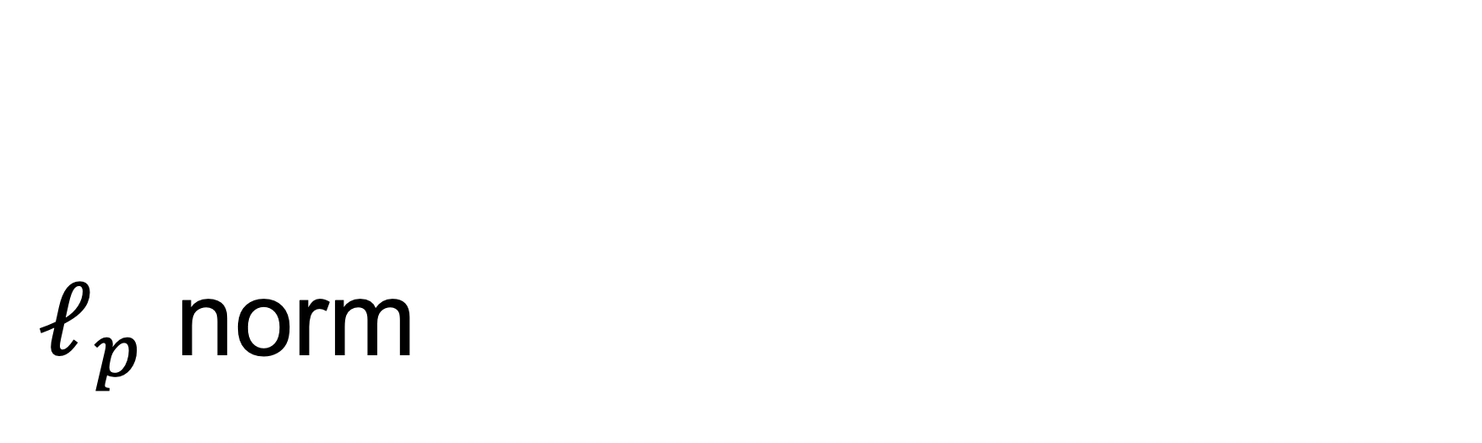
$ℓ_{p}$ norm
A mathemtical detour

Slide 9
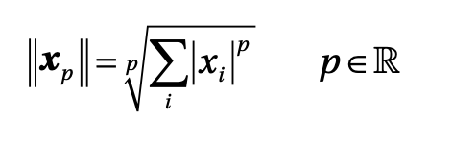
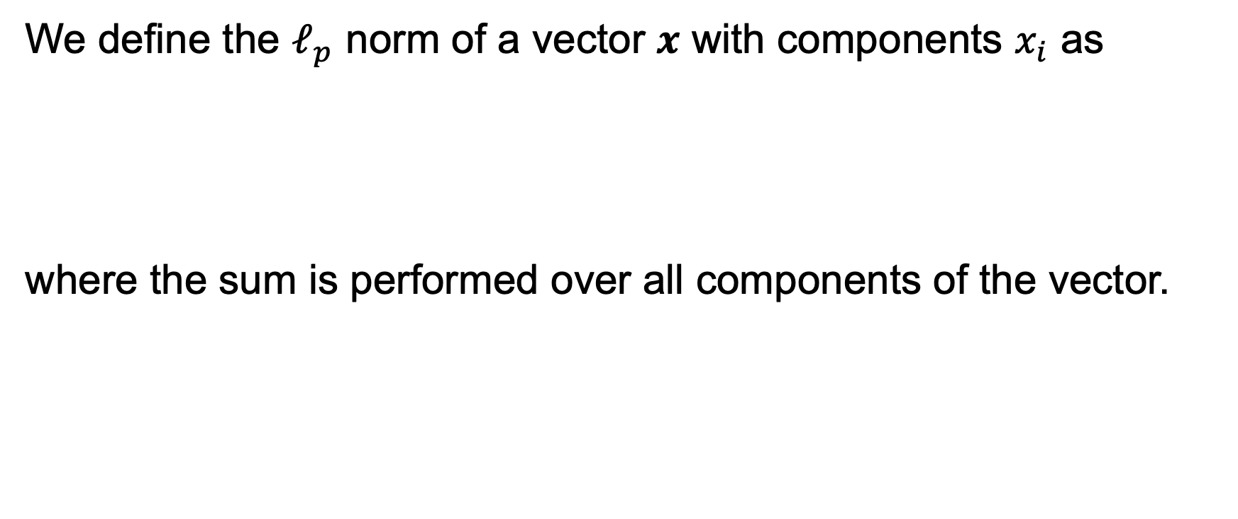
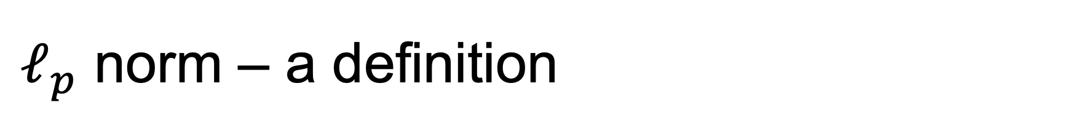
$ℓ_{p}$ norm – a definition
We define the $ℓ_{p}$ norm of a vector $x$ with components $x_{i}$ as
where the sum is performed over all components of the vector.

Slide 10
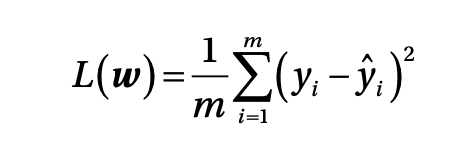
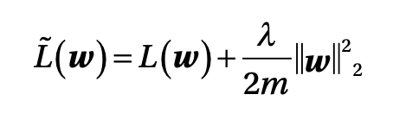
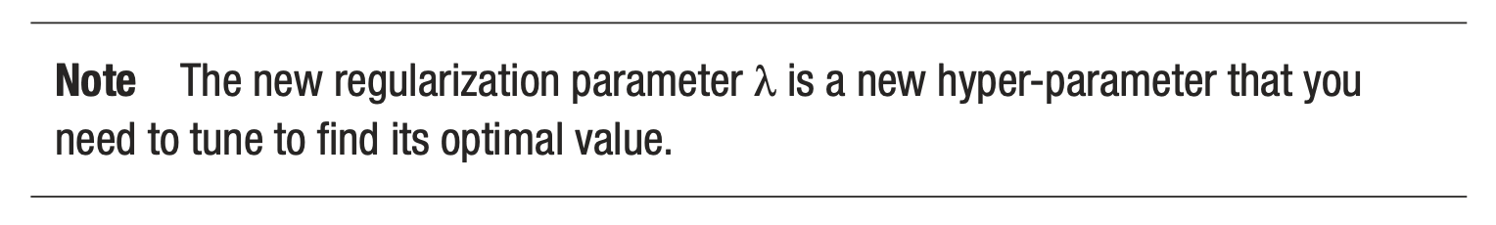
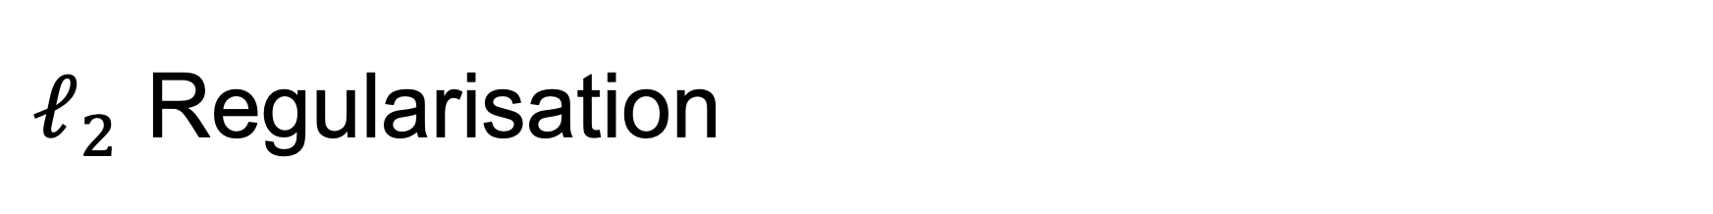
$ℓ_{2}$ Regularisation
It consists of adding a term to the cost function that has the goal of effectively reducing the capacity of the network to adapt to complex datasets.
Let us consider an example
The regularised loss function will be
Regularisation Parameter
Regularisation Term

Slide 11
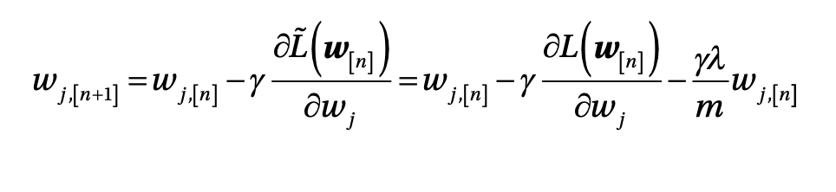
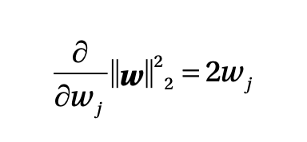
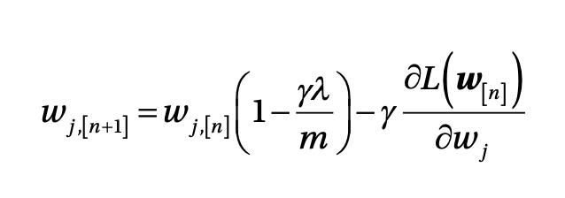
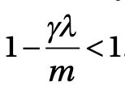
$ℓ_{2}$ Regularisation
Let us consider the gradient descent algorithm
This gives us

Slide 12
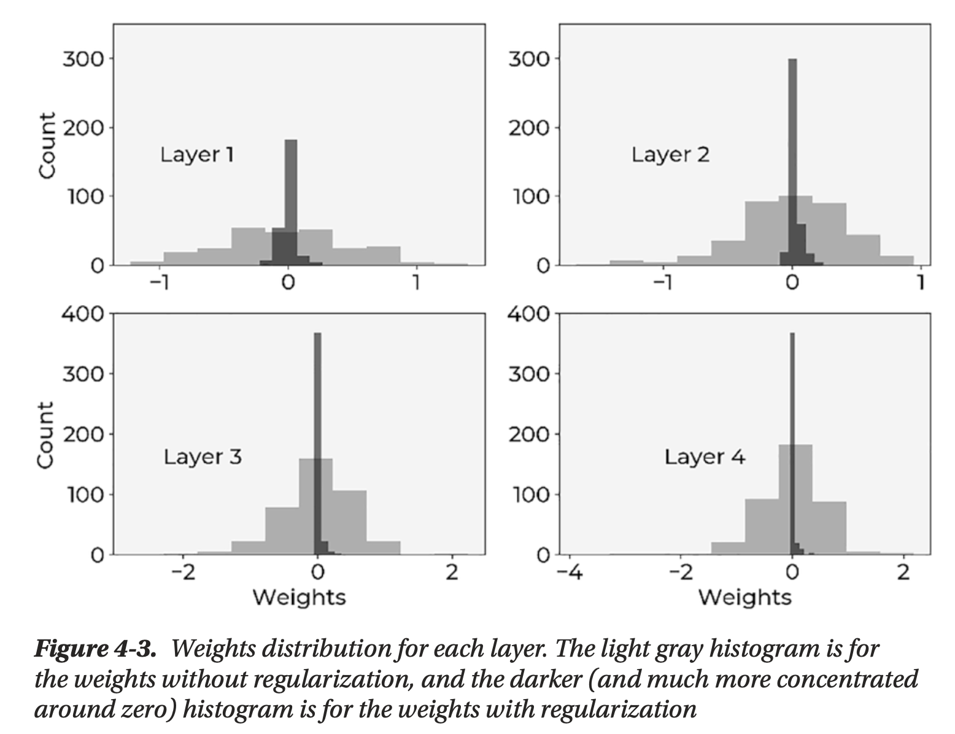
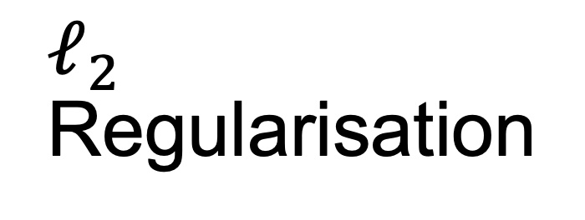
$ℓ_{2}$ Regularisation
Weight distribution change of a 4 layer neural network with and without regularisation → regularisation makes the weights go to zero effectively reducing the number of active neurons.
Michelucci, Umberto. "Applied deep learning." A Case-Based Approach to Understanding Deep Neural Networks (2018).

Slide 13
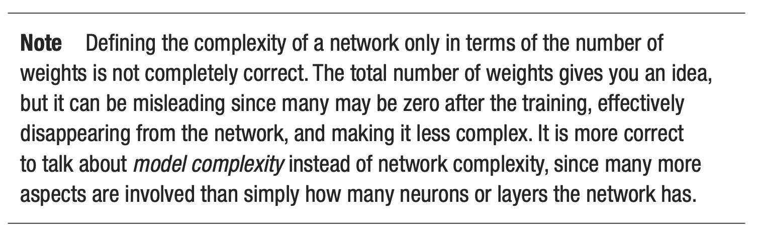
Again about network complexity
Michelucci, Umberto. "Applied deep learning." A Case-Based Approach to Understanding Deep Neural Networks (2018).

Slide 14
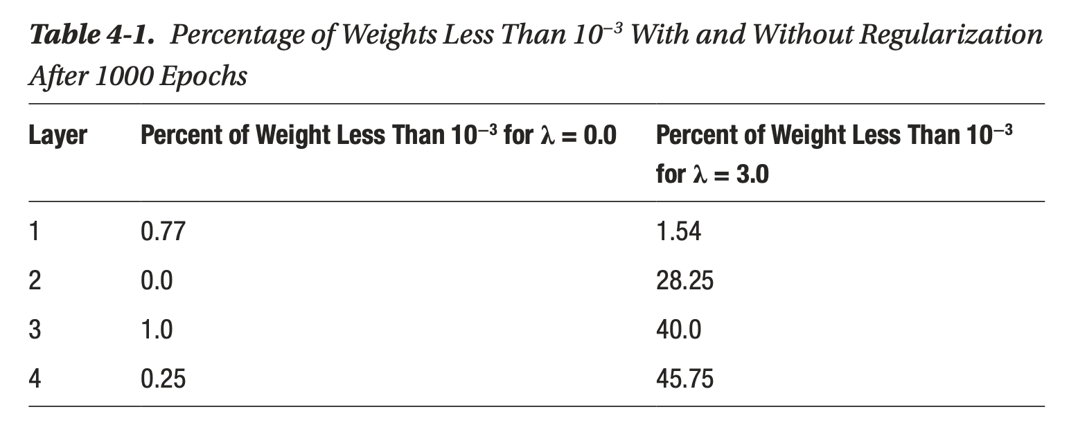
Again about network complexity
Michelucci, Umberto. "Applied deep learning." A Case-Based Approach to Understanding Deep Neural Networks (2018).

Slide 15
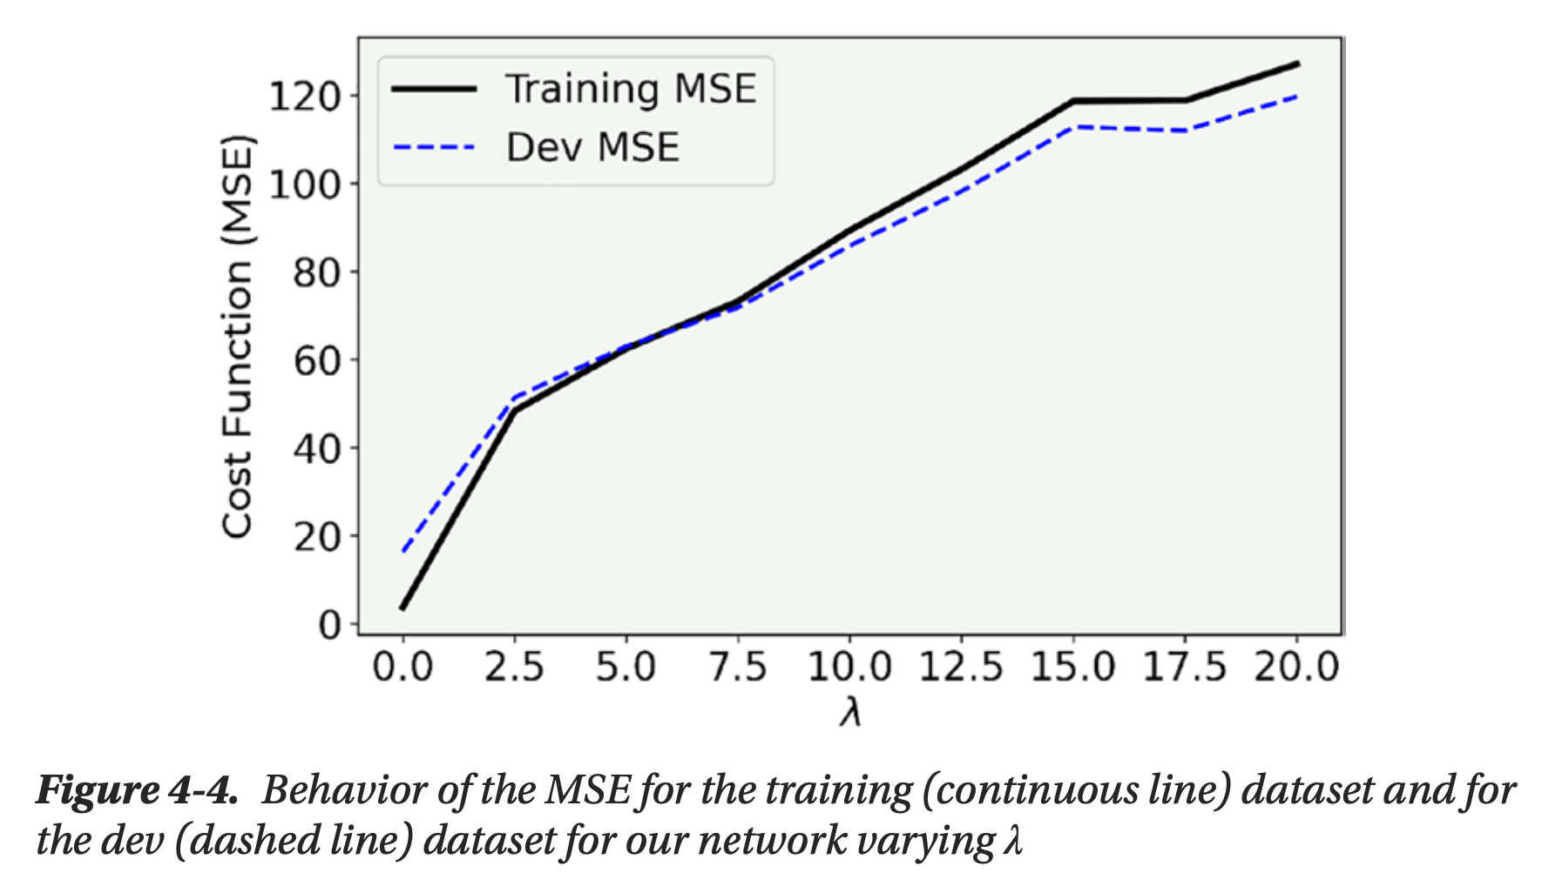
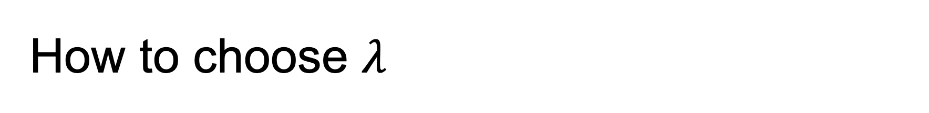
How to choose $λ$
Michelucci, Umberto. "Applied deep learning." A Case-Based Approach to Understanding Deep Neural Networks (2018).

Slide 16
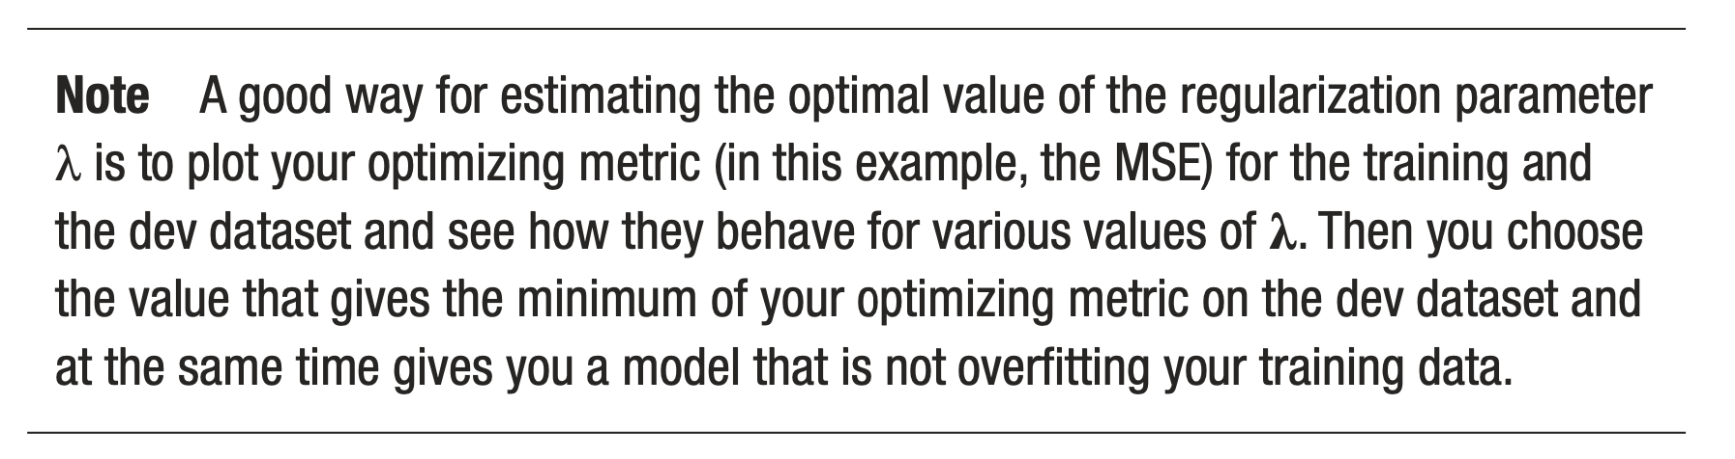
How to choose $λ$
Michelucci, Umberto. "Applied deep learning." A Case-Based Approach to Understanding Deep Neural Networks (2018).

Slide 17
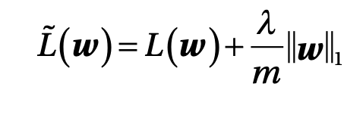
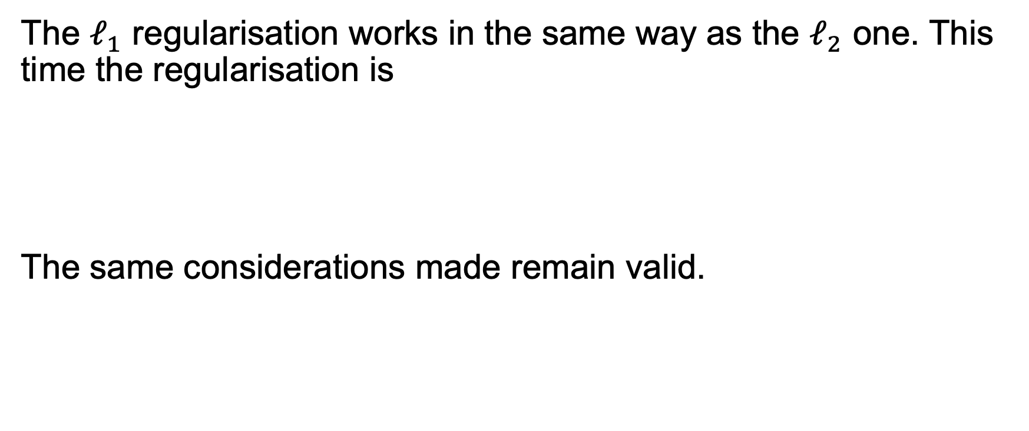
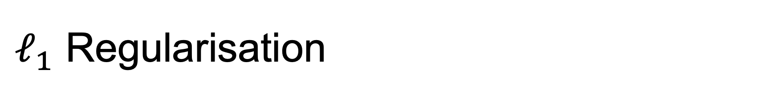
$ℓ_{1}$ Regularisation
The $ℓ_{1}$ regularisation works in the same way as the $ℓ_{2}$ one. This time the regularisation is
The same considerations made remain valid.

Slide 18
Weights going to zero
A mathematical explanation

Slide 19
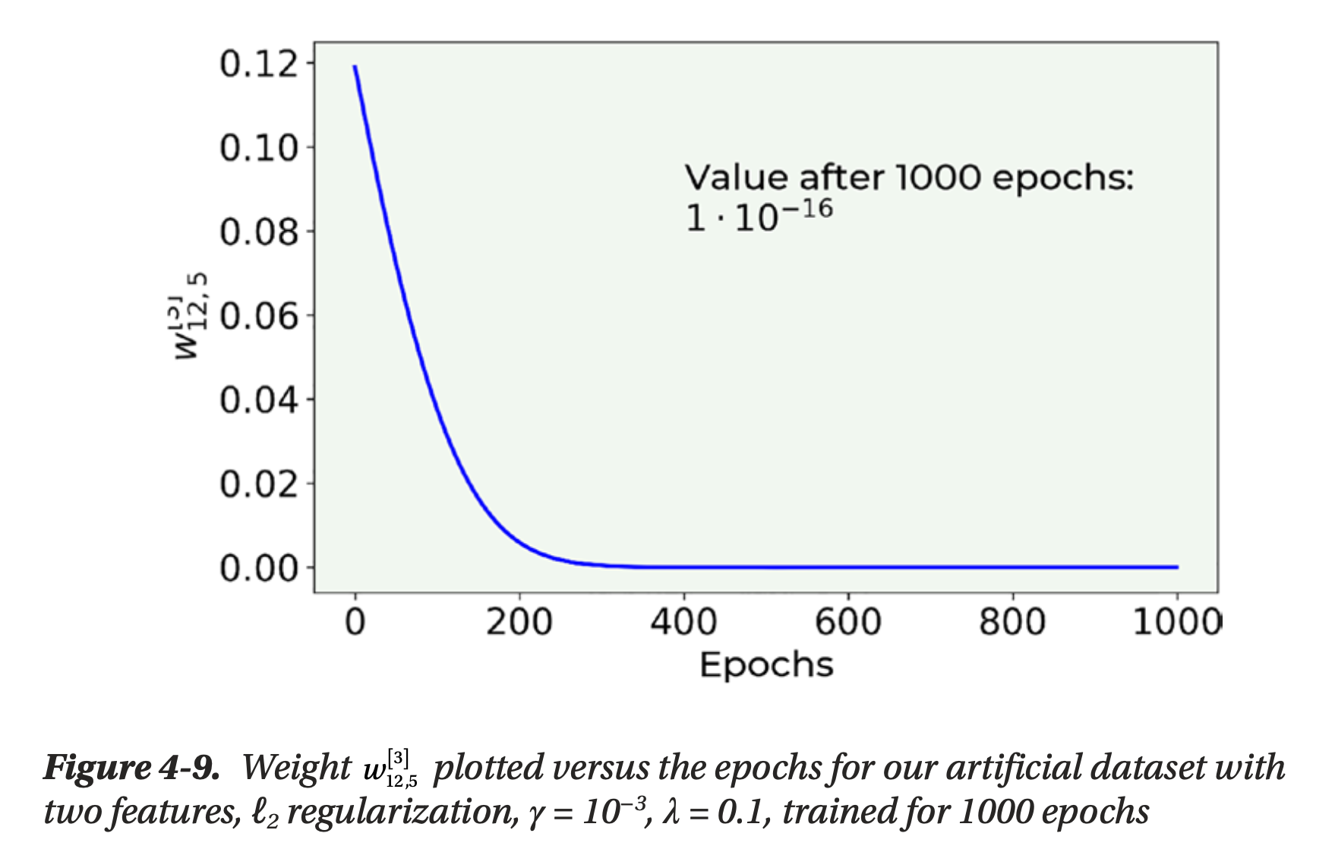
Weights going to zero
Michelucci, Umberto. "Applied deep learning." A Case-Based Approach to Understanding Deep Neural Networks (2018).

Slide 20
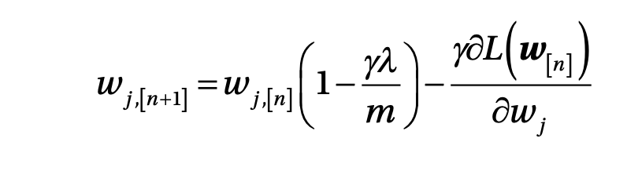
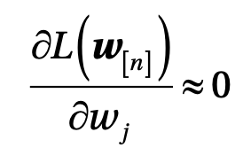
Weights going to zero – a mathematical explanation
consider the weight update equation for one weight
Let’s now suppose we find ourselves close to the minimum, in a region where the derivative of the cost function J is almost zero
Michelucci, Umberto. "Applied deep learning." A Case-Based Approach to Understanding Deep Neural Networks (2018).

Slide 21
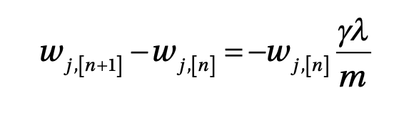
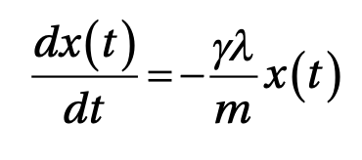
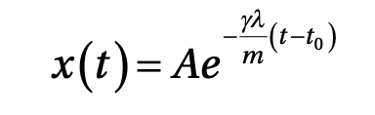
Weights going to zero – a mathematical explanation
We can rewrite the weight update equation as
For those of you with knowledge of differential equations, you may realize that we can draw a parallel to the following equation
Michelucci, Umberto. "Applied deep learning." A Case-Based Approach to Understanding Deep Neural Networks (2018).

Slide 22
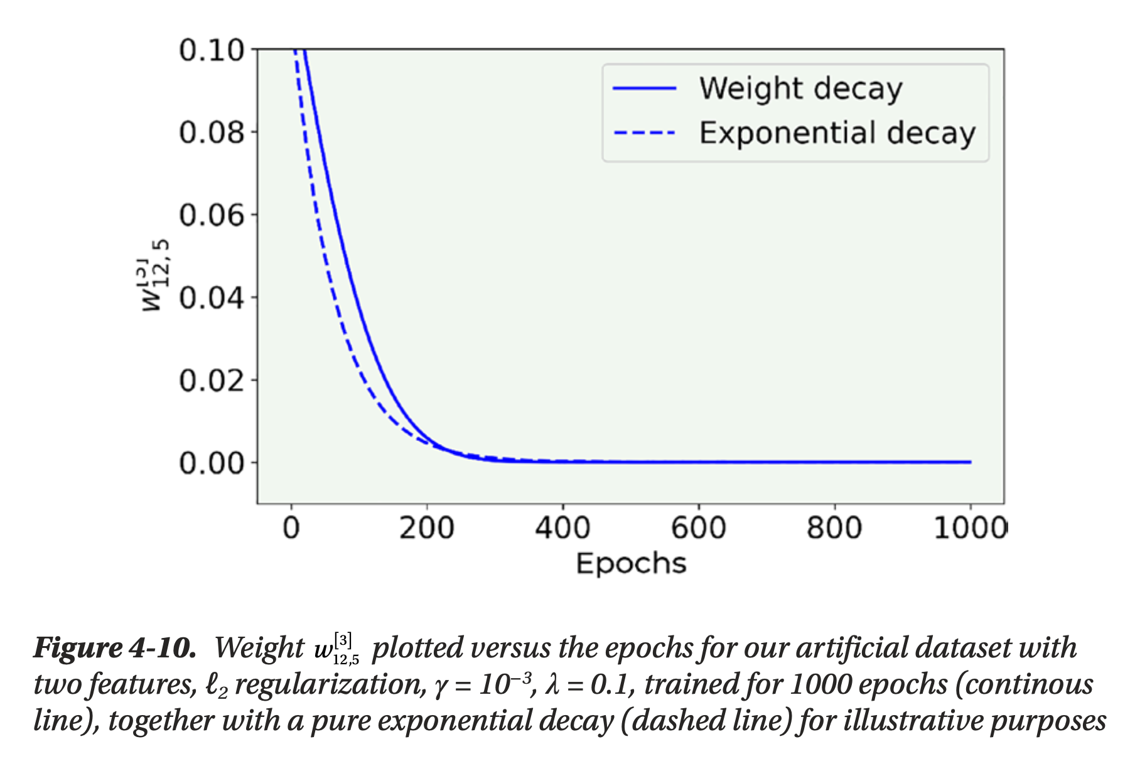
Weights going to zero – a mathematical explanation
Michelucci, Umberto. "Applied deep learning." A Case-Based Approach to Understanding Deep Neural Networks (2018).

Slide 23
Dropout
The most used regualisation method used with neural networks

Slide 24
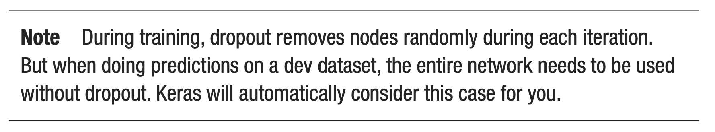
Dropout – the main idea
during the training phase you remove nodes from layer l randomly with a probability p^{[l]}. In each iteration you remove different nodes, effectively training at each iteration a different network (when using mini-batches, you train a different network for each batch, for example)

Slide 25
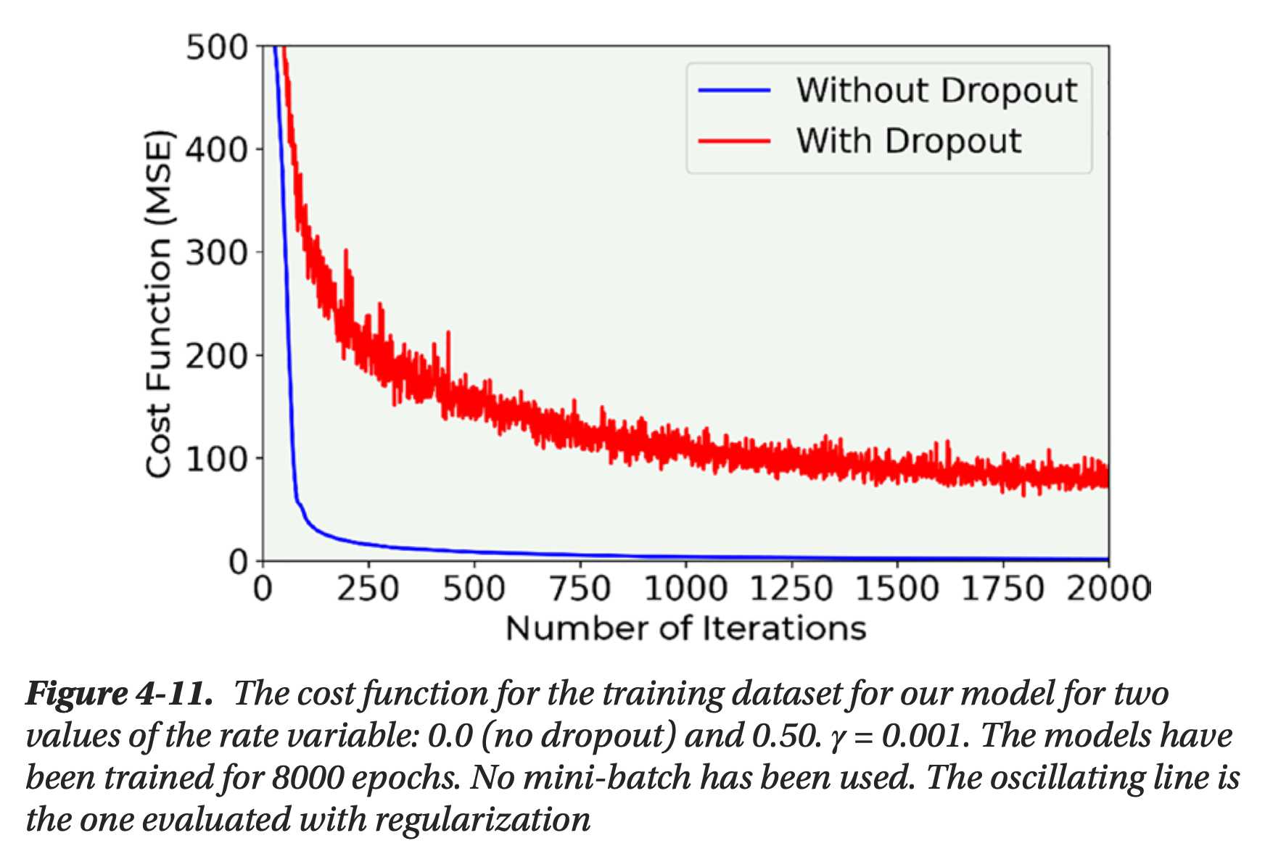
Dropout the main idea

Slide 26
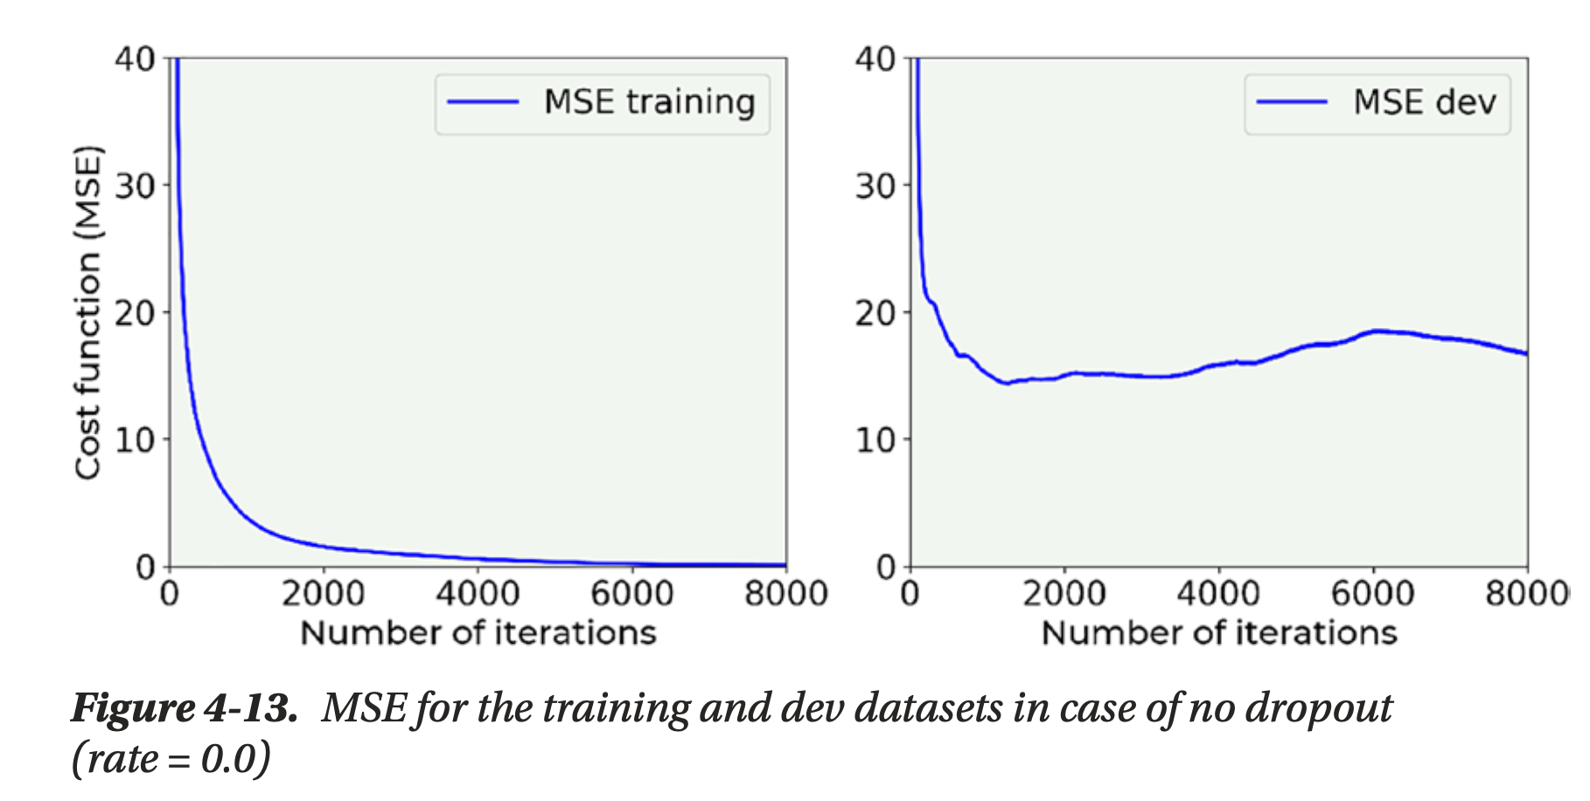
Dropout the main idea

Slide 27
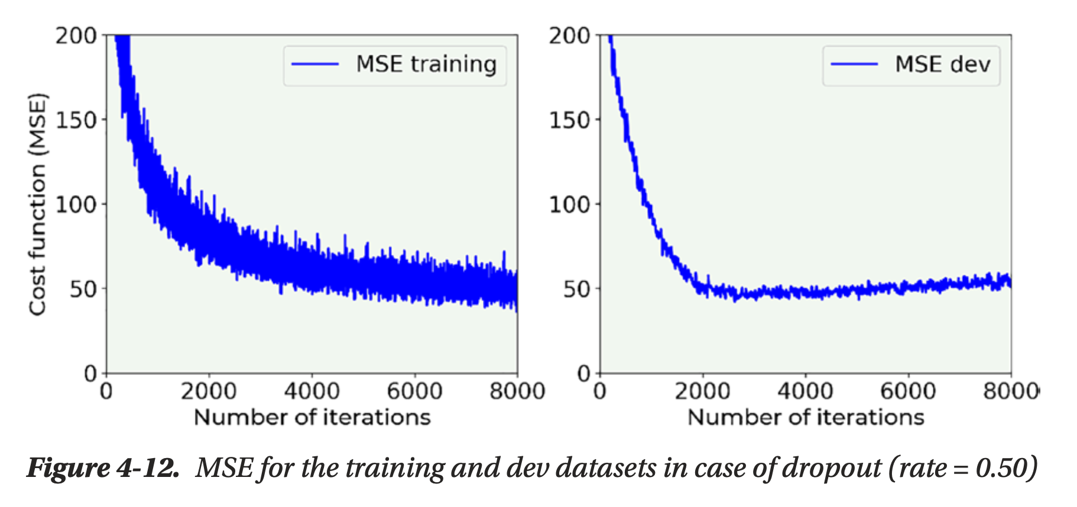
Dropout the main idea

Slide 28
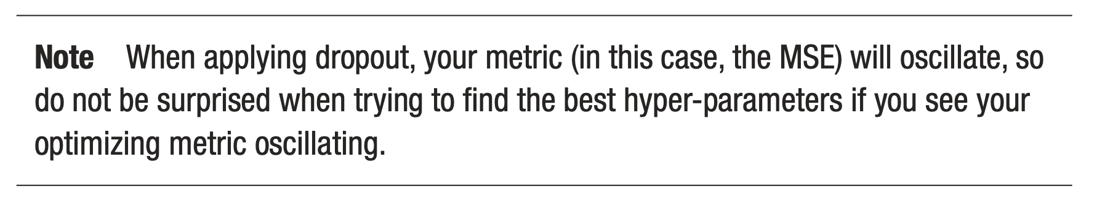
Dropout – a warning

Slide 29
Early stopping
Not really a regularisation approach, but nonetheless useful

Slide 30
Early Stopping
Early stopping is another technique that is sometimes used to fight overfitting. Strictly speaking, this method does nothing to avoid overfitting; it simply stops the learning before the overfitting problem becomes too bad.

Slide 31
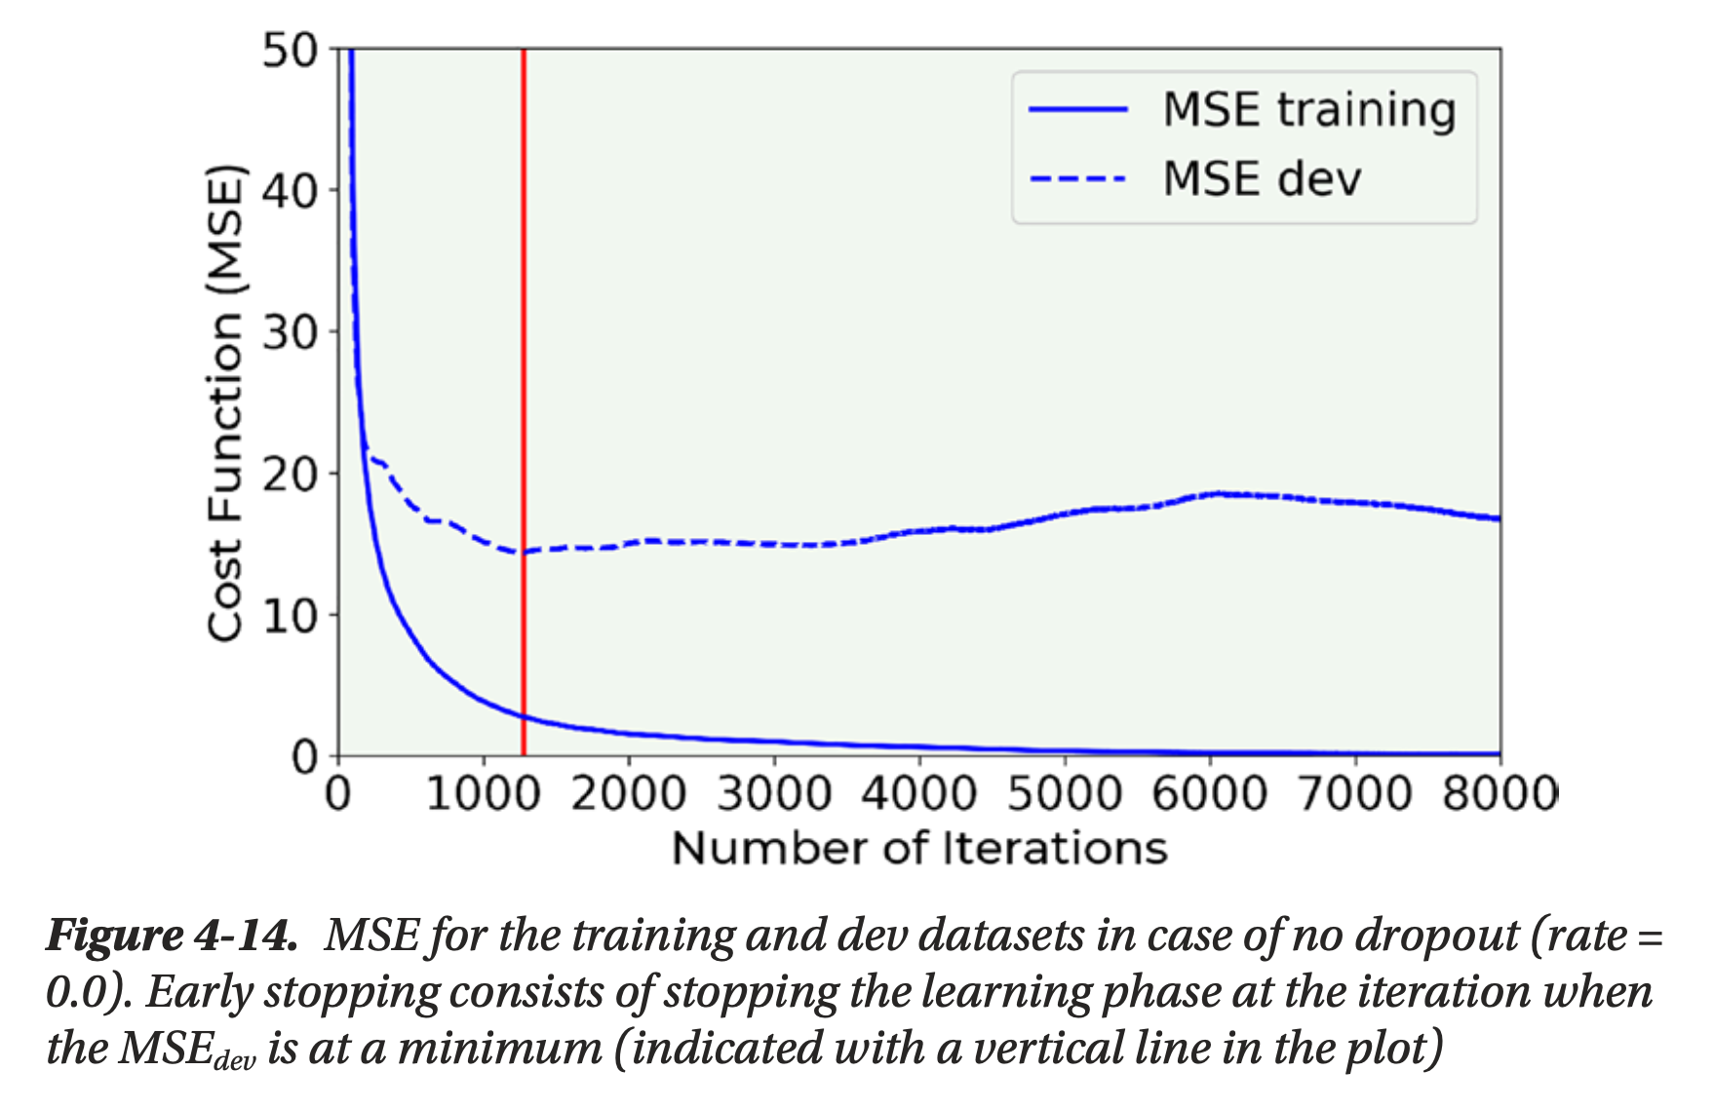
Early Stopping

Slide 32
Early Stopping
Early stopping simply consists of stopping the training at the point when the metric on the validation dataset has its minimum. Note that this is not an ideal way of solving the overfitting problem. Your model will still most probably generalize very badly to new data. It is usually preferable to use other techniques.

Slide 33
Additional Methods
Various and different approaches

Slide 34
Additional Methods
Get more data: This is the simplest way of fighting overfitting. Unfortunately, very often in real life this is not possible. NOTE: If you are classifying pictures of cats taken with a smartphone you may think of getting more data from the web. Although this may seem like a perfectly good idea, you may discover that the images have different quality, that possibly not all the images are really cats (what about cat toys?), you may only find images of white cats, and so on. Basically, your additional observations may come from a very different distribution than your original data and that will be a problem. So, when getting additional data, consider this problem well before proceeding.

Slide 35
Additional Methods
Augment your data. For example, if you are working with images you can generate additional images by rotating, stretching, shifting, and otherwise editing your original images. That is a very common technique that may help.

Slide 36
Warning for TensorFlow
Practice is always different than theory

Slide 37
Warning
Note that in TensorFlow regularisation terms are applied only at layer level, never at loss function level!

